Slide 1







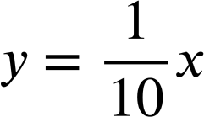
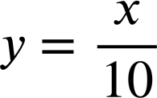
Plotting coordinates generated from a rule
Task A: Finding a rule from a set of coordinates
For each set of coordinates, fill in the gaps to describe the relationship in words and using algebra:
(0,1) (2,3) (9,10)
The x coordinate is equal to the y coordinate plus 1.
(2,6) (-4,0) (4,8)
The x coordinate is equal to the y coordinate plus 4.
(10,5) (4,-1) (0,-5)
The x coordinate is equal to the y coordinate minus 5.
(-7,-2) (-3,2) (2.2,7.2)
The x coordinate is equal to the y coordinate plus 5..
(2,4) (3,6) (8,16)
The x coordinate is double the y coordinate..
(2,20) (-4,-40) (3,30)
The x coordinate is ten times the y coordinate.
(0,0) (1,5) (-1,-5)
The x coordinate is the y coordinate multiplied by 5..
.
(10,1) (6,0.6) (30,3)
The x coordinate is the y coordinate divided by 10.
or

Slide 2




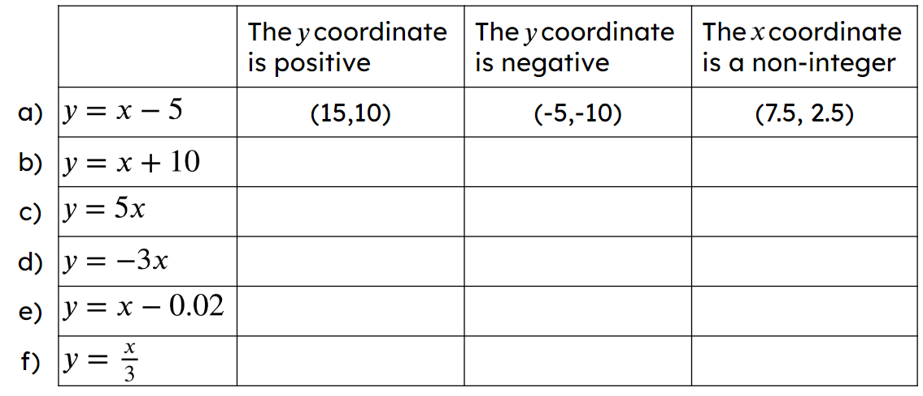
Plotting coordinates generated from a rule
Task B: Generating coordinates from a rule
Generate 3 coordinates that follow each rule. Some have the x or y coordinate already filled in.
There are many possible answers for the blank coordinates. Examples:
( 3 , 23 ) ( , ) ( , )
( 0 , -9 ) ( 18 , 9 ) ( , )
( 0 , 0 ) ( 3 ,300) ( , )
( 0 , 0 ) ( , ) ( , )
(0,20) (1,21) (10,30) (-20,0)
(1,-8) (10,1) (-2,-11) (100,91)
(1,100) (0.1,10) (10,1000) (-3,-300)
(1,4) (2,8) (25,100) (-3,-12)
Fill in the table with a different coordinate for the equation that satisfies each condition. The first one has been done for you.
E.g (-4, 6)
E.g (-20, -10)
E.g (0.2, 10.2)
E.g (2, 10)
E.g (-10, -50)
E.g (0.1, 0.5)
E.g (-3, 9)
E.g (2, -6)
E.g (0.5, -1.5)
E.g (6,5.98)
E.g (-5, -5.02)
E.g (0.52, 0.5)
E.g (9, 3)
E.g (-12, -4)
E.g (3.9, 1.3)
Mathematics in Education and Industry
v2.2

Slide 3
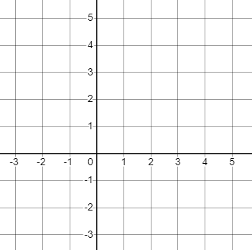
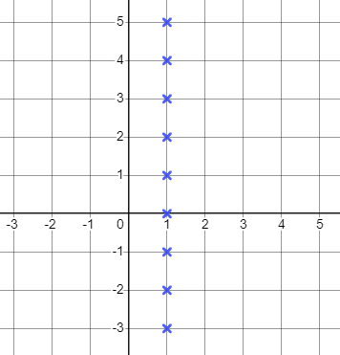
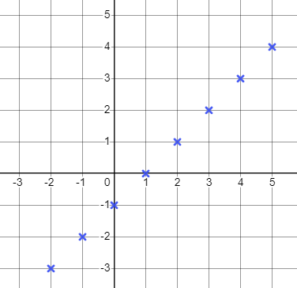
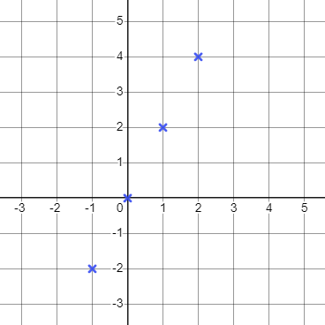



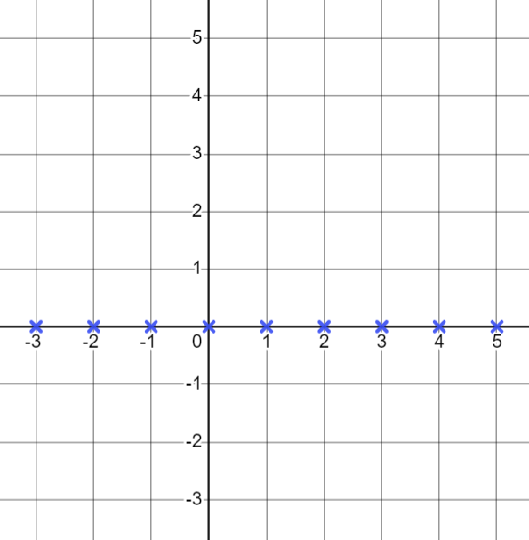
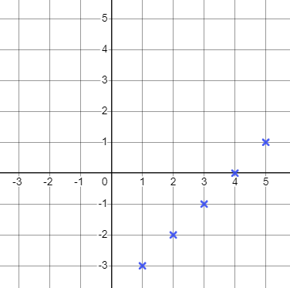
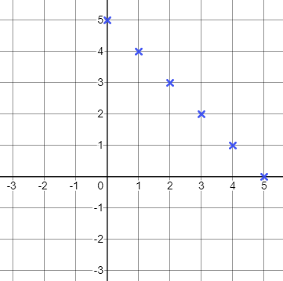
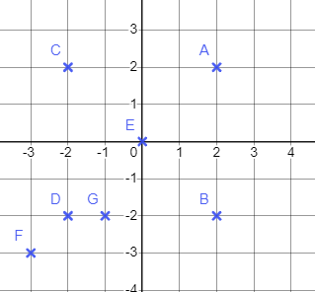




Plotting coordinates generated from a rule
Task C: Plotting coordinates that follow a rule
Plot all the integer points that satisfy each rule.
a) The x value is 1
b) The y value is one less than the x value
c) The y value is double the x value
Describe the pattern
Describe the pattern
Describe the pattern
A vertical line
A diagonal line
A diagonal line
d)
e)
f)
Describe the pattern
Describe the pattern
Describe the pattern
A horizontal line- the axis
A diagonal line
A diagonal line
2) The grid shows seven points labelled A, B, C, D, E, F and G. Complete the table to show which points have coordinates that match the rules below. The first column has been completed for you
Rule | A | B | C | D | E | F | G
 | yes | yes | no | no | no | no | no
 | no | yes | no | yes | no | no | yes
 | yes | no | no | yes | yes | yes | no
 | no | yes | yes | no | yes | no | no
Mathematics in Education and Industry
v2.2

